Slide 1

Preliminary Literature Exploration
Muhammad Shahid Usman 75786

Slide 2
SELECTED PAPERS
No, | Paper | References
1 | High-Resolution Rural Poverty Mapping in Pakistan with Ensemble Deep Learning | https://doi.org/10.1371/journal.pone.0283938
2 | Human Bias and CNNs' Superior Insights in Satellite-Based Poverty Estimation | https://doi.org/10.1038/s41598-024-74150-9​
3 | Poverty Mapping in the Age of Machine Learning (World Bank) | https://openknowledge.worldbank.org/entities/publication
4 | A Review of Machine Learning and Satellite Imagery for Poverty Prediction | https://doi.org/10.1002/jid.3751
5 | Exploring Machine Learning Trends in Poverty Mapping | https://doi.org/10.1016/j.srs.2025.100200
6 | Mapping Income Poverty in Belize Using Satellite Features and Machine Learning | http://dx.doi.org/10.18235/0002345
7 | Machine Learning Study Using 2020 SDHS Data to Determine Poverty Drivers in Somalia | https://doi.org/10.1038/s41598-024-56466-8
8 | The Livelihood and Poverty Mapping Analysis at Regional Scale in Pakistan | https://edepot.wur.nl/355191
I've identified eight high-quality, recent papers (2020-2025) from credible sources. Below is the detailed analysis for each:

Slide 3
Paper 01
High-Resolution Rural Poverty Mapping in Pakistan with Ensemble Deep Learning
Purpose: To develop a high-resolution (1 km²) poverty map for rural Sindh, Pakistan, using ensemble deep learning to overcome limitations of traditional census-based approaches and enable better targeting of social welfare interventions.
Key Findings/Contributions: Ensemble model achieved superior performance compared to individual CNNs in predicting chronic poverty. Successfully differentiated between chronically poor and not chronically poor rural areas at 1 km² resolution, much finer than previous Pakistan studies
Methods:
Data: 1.67 million georeferenced household observations from Pakistan's Simple Poverty Scorecard (SPSU) survey (2016-2019)
Models: Transfer learning approach using three CNN architectures (ResNet50, ResNet50V2, ResNet101) pre-trained on ImageNet
Ensemble: Combined the three models to create a robust predictor
Resolution: 1 km² grid cells with median poverty scores, dropped cells with <3 or >300 observations to reduce noise
Validation: Cross-validation plus ground truthing with original field survey
Limitations/Gaps:
Spatial Noise: Training data had GPS errors—coordinates often captured in fields/roads rather than actual household locations, requiring 1 km² aggregation
Urban Exclusion: Study explicitly focused on rural areas; dropped all urban/peri-urban observations, leaving urban poverty unmapped
Geographic Limitation: Only covered Sindh Province; not tested in other Pakistani provinces with different terrains (Punjab, KPK, Balochistan.

Slide 4
Paper 02
Human Bias and CNNs' Superior Insights in Satellite-Based Poverty Estimation
Purpose: To compare human expert judgment versus CNN-based approaches for poverty estimation from satellite imagery, investigating where and why AI outperforms humans using Tanzania as a case study.
Key Findings/Contributions: CNN Superiority: CNN using medium-resolution imagery significantly outperformed human experts using high-resolution imagery. CNNs learn visual patterns that are invisible or unrecognisable to humans, potentially capturing subtle poverty indicators.
Methods:
Human Expert Phase: Experts ranked poverty levels of 200 clusters from the Tanzania DHS survey using high-resolution Google Earth imagery.
Expert-ML Hybrid: Used expert-defined features (building density, road quality, vegetation) in traditional machine learning classifiers (Random Forest, SVM).
Pure CNN Approach: Trained a convolutional neural network on medium-resolution satellite images of the same locations without expert feature engineering.
Explainability: Applied SHAP (SHapley Additive exPlanations) to assess feature importance and interactions in expert-based models.
Comparison: Compared accuracy across all three approaches.
Limitations/Gaps:
Single Country: Only tested in Tanzania; generalizability to other cultural/geographic contexts unknown
Resolution Trade-off: CNNs used medium-resolution images while experts had high-resolution access; unfair comparison
Small Sample: 200 clusters may be insufficient for robust conclusions about human vs. AI performance.
Temporal Snapshot: Single time-point analysis; doesn't assess poverty change detection over time

Slide 5
Paper 03
Poverty Mapping in the Age of Machine Learning (World Bank)
Purpose: To demonstrate that combining satellite imagery with household surveys improves precision and accuracy of poverty estimates at municipal level (small areas not representative in surveys) in Mexico.
Key Findings/Contributions: Improved Precision: Satellite+ML approach improved poverty estimate precision at municipal level (non-representative in surveys)​. Household Model Advantage: Household-level modeling outperformed other standard SAE methods.
Methods:
Data: Mexican household surveys + Sentinel-2 satellite imagery (2015-2020).
Small Area Estimation (SAE): Traditional statistical technique for estimating indicators in areas with small/no survey samples.
ML Integration: Extracted satellite-derived features (nightlights, NDVI, building density) and incorporated into SAE models.
Household-Level Model: Built models at household level rather than aggregating first.
Comparison: Compared accuracy across all three approaches.
Limitations/Gaps:
Census Still Better: 2015 satellite-based estimates were less accurate than 2010 census estimates, suggesting satellite data supplements but doesn't fully replace census.
Requires Survey Data: Still needs household survey for training; not a standalone approach.
Municipal Level Only: Didn't achieve neighborhood-level granularity; limited by survey representativeness.
Mexico-Specific: Findings from middle-income Mexico may not transfer to lower-income countries with different poverty manifestations.

Slide 6
Paper 04
A Review of Machine Learning and Satellite Imagery for Poverty Prediction
Purpose: To systematically analyse the expanding literature on poverty prediction using machine learning and satellite imagery, identifying trends, methodologies, challenges, and implications for development policy.
Key Findings/Contributions: Rapid Growth: Exponential increase in publications since 2016​. Nighttime lights + daytime imagery most common combination; transfer learning from ImageNet widespread. Geographic Bias: Most studies focus on Africa (60%) and Asia (30%); Latin America and the Middle East are underrepresented.
Methods:
Systematic Literature Review: Statistical analysis of 60+ papers published in the domain.
Categorisation: Papers classified by geographic region, ML algorithms used, satellite data sources, poverty indicators, and validation methods.
Trend Analysis: Temporal trends in publications, methodological evolution, and accuracy improvements over time.
Gap Analysis: Identified under-researched areas and methodological limitations across the field.
Limitations/Gaps:
Urban Poverty Gap: Most studies focus on rural areas; urban informal settlements underexplored.
Temporal Dynamics: Limited research on poverty change detection over time (longitudinal studies).
Interpretability: Black-box nature of CNNs makes it difficult for policymakers to trust and act on predictions.
Policy Integration: Few studies demonstrate actual integration into government decision-making processes.
Multidimensional Poverty: Most focus on income poverty; limited work on multidimensional poverty indices

Slide 7
Paper 05
Exploring Machine Learning Trends in Poverty Mapping
Purpose: To explore emerging trends in ML-based poverty mapping, particularly integration of multiple data sources (satellite imagery + mobile phone data + social media) for a high-resolution, frequently updated poverty map.
Key Findings/Contributions: Data Fusion Advantage: Combining satellite imagery with mobile phone data creates higher-resolution poverty maps than either source alone. Regular Updates: Mobile/social media data enables quarterly or monthly poverty map updates, rather than 3-5-year survey cycles.
Methods:
Literature Synthesis: Analysis of recent (2020-2025) poverty mapping studies.
Multi-Source Data Integration: Focus on studies combining satellite data with call detail records (CDRs), social media activity, and financial transactions.
Trend Identification: Emerging methodologies, data fusion techniques, and real-time updating capabilities.
Limitations/Gaps:
Data Access: Mobile phone data is often proprietary; it is difficult for researchers to access, limiting replicability.
Digital Divide: Mobile data-based approaches exclude the poorest populations without phones, potentially biasing the estimate.
Validation Challenges: High update frequency makes ground-truth validation difficult and expensive.
Developing Countries: Advanced data fusion requires infrastructure (mobile networks, internet) not universally available.
Methodological Complexity: Combining heterogeneous data sources requires sophisticated data engineering, increasing barriers to adoption

Slide 8
Paper 06
Mapping Income Poverty in Belize Using Satellite Features and Machine Learning
Purpose: To create poverty maps for Belize using free, open-source methodologies linking satellite imagery and survey data with ML, addressing the 11-year gap since Belize's last poverty assessment (2009).
Key Findings/Contributions: Cost-Effective: Demonstrated poverty mapping at reduced cost compared to comprehensive household surveys. Free Satellite Data: Exclusively uses freely available Sentinel-2 and MODIS, no commercial imagery required.
Methods:
Data: Household survey data from 2009 + Sentinel-2 and MODIS satellite imagery (2018-2019).
Feature Extraction: Manual extraction of features from satellite images: NDVI (vegetation), nighttime lights intensity, urban extent, road density.
ML Model: Random Forest regression to predict average district-level income.
Small Area Estimation: Incorporated satellite features into SAE framework for sub-national estimates.
Limitations/Gaps:
District-Level Only: Achieved only district-level resolution; insufficient for neighbourhood-level targeting.
Old Survey Data: Trained on 2009 survey data applied to 2018-2019 imagery; 10-year gap introduces uncertainty.
Manual Features: Relied on hand-crafted features rather than deep learning's automatic feature extraction.
Limited Validation: Belize's lack of recent survey data meant limited ability to validate predictions rigorously.
Small Country: Methodology tested in small country (population 400,000); scalability to large, diverse countries uncertain

Slide 9
Paper 07
Machine Learning Study Using 2020 SDHS Data to Determine Poverty Drivers in Somalia
Purpose: To apply advanced ML methods to predict poverty in Somalia (one of world's highest poverty rates) and identify key poverty drivers, moving beyond conventional regression analysis with limited predictive capability.
Key Findings/Contributions: Random Forest Best: RF achieved highest accuracy (78%) and AUROC (0.82) among tested algorithms. ML Advantage: ML methods (especially RF) significantly outperformed conventional logistic regression in predictive accuracy.
Methods:
Data: 2020 Somalia Demographic and Health Survey (SDHS)—first-ever comprehensive survey in Somalia.
ML Algorithms: Random Forest (RF), Decision Tree (DT), Support Vector Machine (SVM), and Logistic Regression tested and compared.
Software: R (version 4.1.2) for ML analysis, STATA 17 for conventional regressio.
Predictor Variables: Education, household size, assets, employment, geographic location, access to services.
Limitations/Gaps:
No Satellite Data: Study relied solely on survey data; didn't incorporate satellite imagery or geospatial features.
Cross-Sectional: Single time-point; cannot assess poverty dynamics or trends.
Survey-Based: Subject to same limitations as traditional surveys (cost, time, spatial coverage).
Interpretability: While RF performed best, its complex decision trees make interpretation difficult for policymakers.
Somalia-Specific: Findings specific to Somalia's unique context (conflict-affected, limited infrastructure); generalizability limited.

Slide 10
Paper 08
The Livelihood and Poverty Mapping Analysis at the Regional Scale in Pakistan
Purpose: To map both unidimensional (income-based) and multidimensional poverty simultaneously in Pakistan at the district level, providing the first comprehensive poverty maps showing spatial distribution across all four provinces.
Key Findings/Contributions: Multi-Dimensional Worse: Multi-dimensional poverty rates are substantially higher than income poverty, indicating severe social sector underdevelopment. ML Advantage: Urban-Rural Gap: Rural areas have much higher poverty incidence than urban centres across all provinces.
Methods:
Data: PSLM 2010-11 survey data for multi-dimensional poverty; HIES (Household Integrated Economic Survey) 2010-11 for income poverty.
Small Area Estimation: Used SAE technique to generate district-level poverty estimates from nationally representative surveys.
Poverty Measures: Uni-dimensional (income below poverty line) and multi-dimensional (education, health, living standards).
Spatial Analysis: Mapped poverty distribution across districts, identifying poverty pockets and geographic patterns.
Limitations/Gaps:
2010-11 Data: Now outdated (14+ years old); poverty patterns likely changed significantly.
District-Level Only: Provided district aggregates; insufficient for sub-district/neighborhood-level targeting.
No Satellite Data: Traditional survey-based approach; doesn't leverage remote sensing potential.
Static Snapshot: Single time-point; no analysis of poverty dynamics or trends.
Limited Lahore Focus: Aggregated the entire Lahore district without intra-city spatial analysis.

Slide 11
SYNTHESIS OF FINDINGS
Key Points:
🚀 Transformative Shift
Traditional census/surveys → Satellite + AI methods
70% of studies now use CNN-based approaches
Driven by: Free satellite data + Deep learning maturity + Policy demand
🌍 Geographic Focus
60% Sub-Saharan Africa, 30% South Asia
Pakistan = key testbed (Sindh mapping, PSLM-based studies)
🔬 Two Technical Paradigms
Transfer Learning CNNs: ImageNet → Satellite imagery fine-tuning
Traditional ML: Random Forest/SVM + hand-crafted features (NDVI, nightlights)
Winner: CNNs outperform humans AND traditional ML
📊 Resolution Progress
National → District → 1 km² grid cells
Gap: Urban neighborhoods (100-500m) still rare
Evolution of Poverty Mapping (2020-2025)

Slide 12
Common Challenges
Challenge | Impact
Ground-Truth Quality | GPS errors ±50-100m, temporal misalignment
Urban-Rural Divide | 80% studies = rural; urban slums underexplored
Black Box Problem | CNNs accurate but unexplainable → policy distrust
Validation Gap | Expensive field surveys; most use same-source testing
Poor Generalizability | Models fail across countries/regions
Data Access | Mobile data proprietary; high-res imagery costly
Infrastructure | GPUs, storage, expertise = barriers for LMICs
Critical Challenges in Poverty Mapping

Slide 13
GAP STATEMENT
Spatial Inadequacy:Studies focus on rural areas or district-level aggregates, lacking the neighbourhood-level granularity (100m-500m) required for targeted urban poverty interventions in heterogeneous cities like Lahore.
Architectural Inflexibility: Monolithic ML pipelines prevent modular reuse of analytical components by different government agencies, limiting scalability and cross-domain knowledge transfer. No framework exists for microservices-based geospatial feature extraction with quantified reusability metric
Policy Integration Gap: Despite technical accuracy improvements, few systems demonstrate operational deployment within government decision-making infrastructure, and none integrate poverty mapping with complementary policy domains (e.g., renewable energy planning via solar panel detection).
While recent advances in satellite-based poverty mapping demonstrate feasibility and accuracy improvements through deep learning, existing work suffers from three critical limitations when applied to Pakistani urban policy contexts:

Slide 14
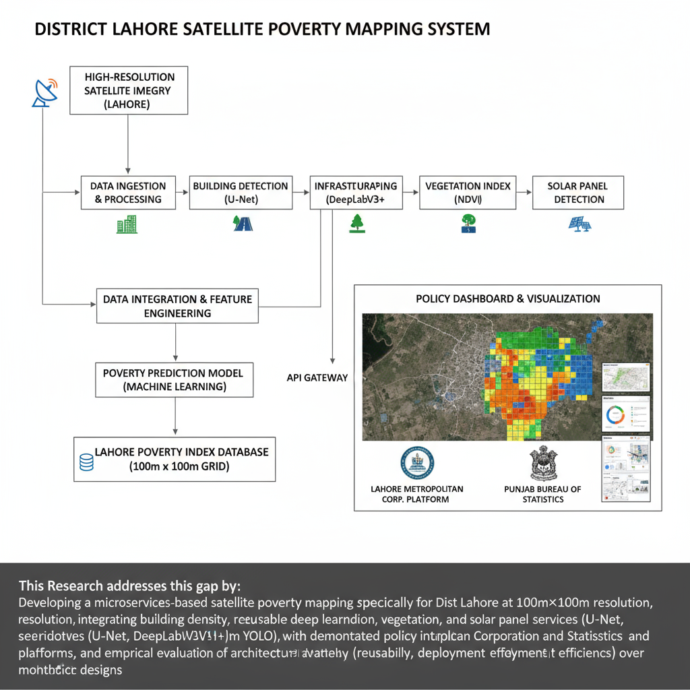
This Research addresses this gap by:
Developing a microservices-based satellite poverty mapping system specifically for District Lahore at 100m×100m resolution, integrating building density, infrastructure, vegetation, and solar panel indicators through independent, reusable deep learning services (U-Net, DeepLabV3+, YOLO), with demonstrated policy integration via Lahore Metropolitan Corporation and Punjab Bureau of Statistics platforms, and empirical evaluation of architectural advantages (reusability, maintainability, deployment efficiency) over monolithic designs

Slide 15
Generalised Problem Statement
Urban poverty assessment in developing countries relies predominantly on infrequent household surveys that lack the spatial granularity and temporal resolution required for evidence-based policy interventions. Traditional census and survey-based approaches, conducted at 3-5 year intervals, provide only district or provincial-level aggregates, masking intra-urban heterogeneity and delaying response to rapidly changing socioeconomic conditions. While recent advances in satellite remote sensing and deep learning demonstrate the feasibility of high-resolution poverty mapping, existing approaches suffer from three critical limitations:
(1) architectural inflexibility, monolithic machine learning pipelines prevent modular reuse of analytical components across government agencies,
(2) urban context gap: most studies focus on rural areas, leaving heterogeneous urban neighbourhoods unmapped at policy-relevant scales (100-500m resolution), and
(3) policy integration deficit: Few systems demonstrate operational deployment within the government decision-making infrastructure.
These limitations collectively hinder the scalability, maintainability, and actionable impact of satellite-based poverty monitoring systems in resource-constrained urban governance contexts

